Slide 1
Spring MVC Spring Boot JPA in 2020
Linkedin: Hamdamboy

Slide 2
Important key values:
Spring
Spring MVC
Spring Boot
Spring Tool Suite
Maven
Java
Apache Tomcat

Slide 3
About Spring
Spring is a framework for dependency-injection. Which is a pattern which allows to build very decoupled systems.
Company
Students
object

Slide 4
Spring MVC
The Spring Web model-view-controller (MVC) framework is designed around a Dispatcher Servlet that dispatches requests to handlers, with configurable handle mappings, view resolution, locale, time zone, and theme resolution as well as support uploading files.
Spring Boot
Spring Boot makes it easy to create stand-alone, production-grade.
Spring based applications that you can just run.
pom, gradle
Spring Boot
Spring Boot makes it easy to create stand-alone, production-grade.
Spring based applications that you can just run.
pom, gradle

Slide 5
Spring Tool Suite
Spring Tool Suites is an Eclipse-based development environment that is customized for developing Spring applications.
Maven
Apache Maven is a software project management and comprehension tool.
Based on the concept of a project object model (POM), Maven can manage a project’s build, reporting and documentation form a central piece of information.
Apache Tomcat
Apache Tomcat, often referred to as Tomcat Server, is an open-source Java Servlet Container developed by the Apache Software Foundation (ASF).

Slide 6
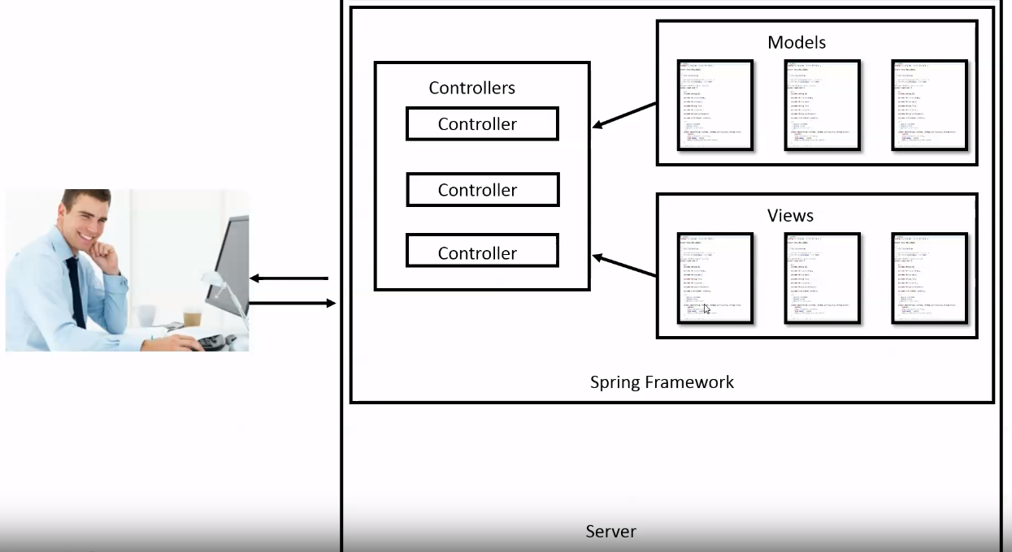
Spring MVC

